Slide 1

GOPHER BATHROOMS
Group 4: Rachel, Leo, Nyi, Ikran Lennon, and Ekin

Slide 2

PROBLEM CONTEXT
Did you know that the comfort and hygiene of university bathrooms play a crucial role in students' daily lives?
Students often face unsatisfactory conditions in UMN bathrooms but have lacked a direct way to report and communicate about these issues. This has led to ongoing challenges in maintaining bathroom standards across campus.
Which is why we are introducing the Gopher Bathrooms App with three main features to tackle these ongoing issues.
Bathroom Navigations
Bathroom Rating/Reviews
Reporting System

Slide 3
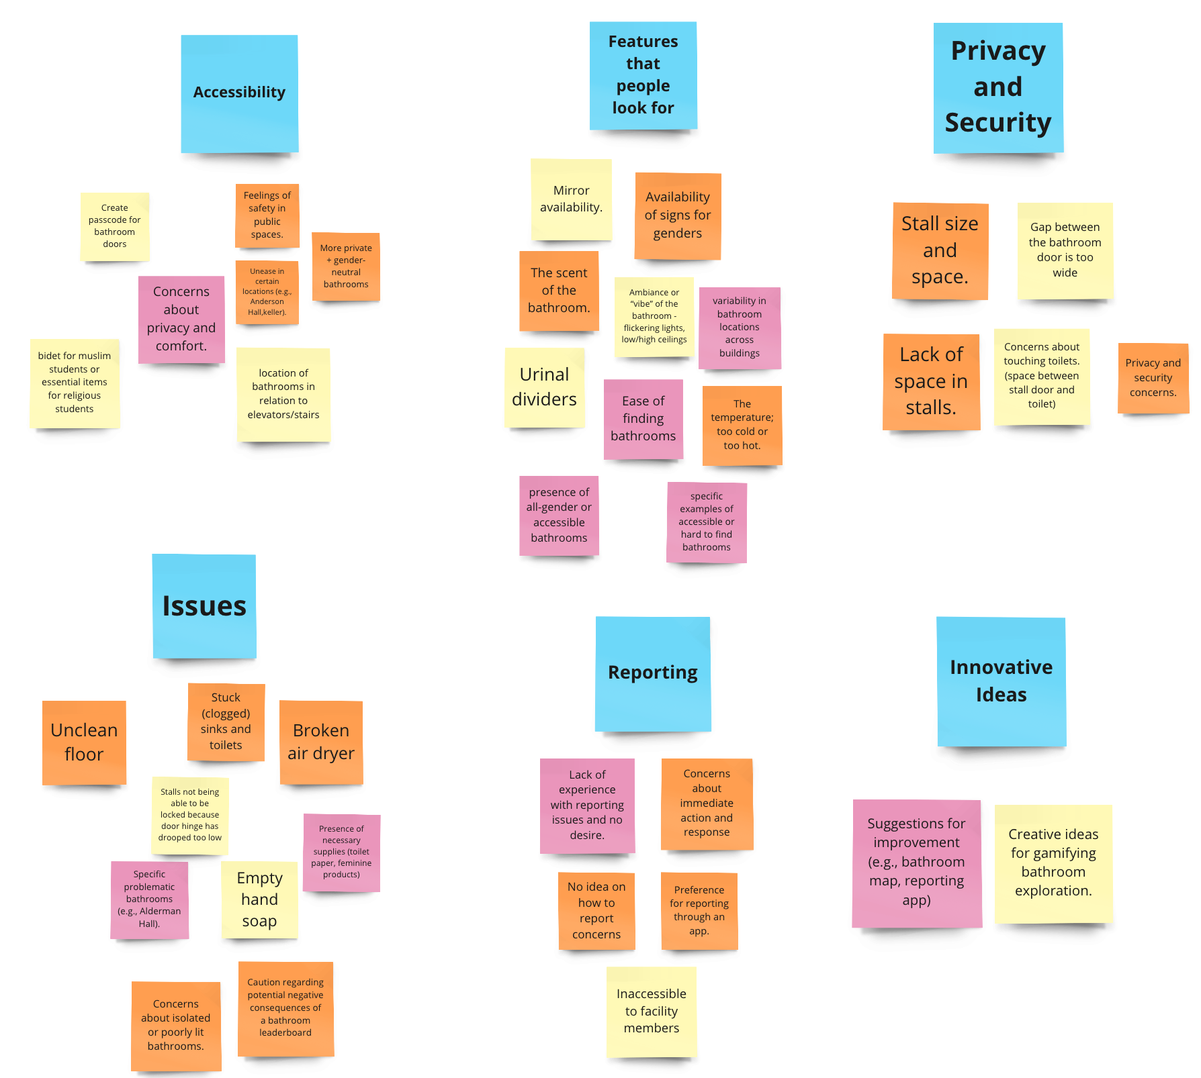
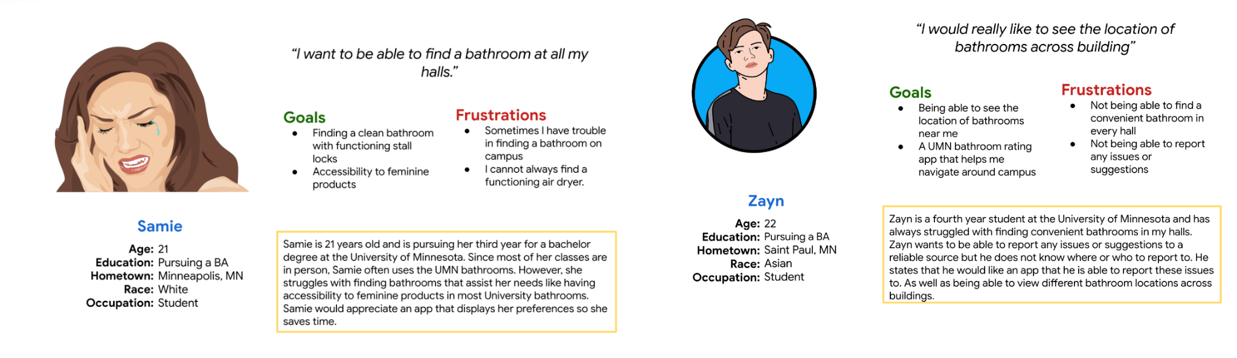
RESEARCH & FINDINGS
Methodology
Survey questionnaire to gain general knowledge.
Individual user interviews to gain perspective specific questions.
Findings
Gained valuable insights into the needs, pain points, and behaviors of our target audience.
Discovered specific challenges users face in navigating and utilizing campus bathrooms, as well as their preferences for cleanliness, safety, accessibility and more tackled in our app.

Slide 4
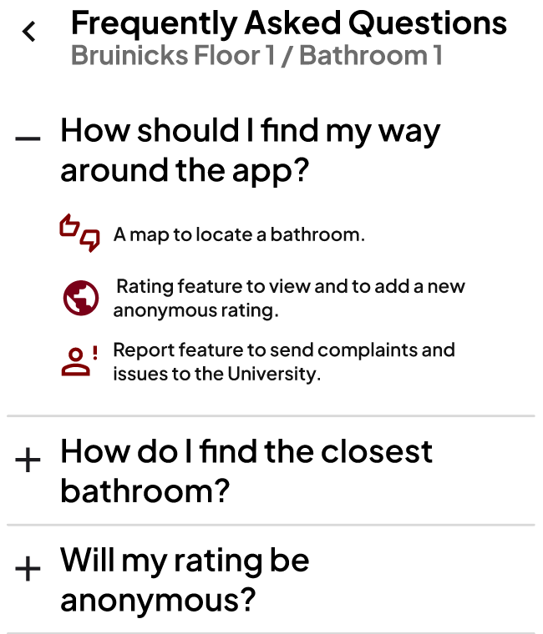
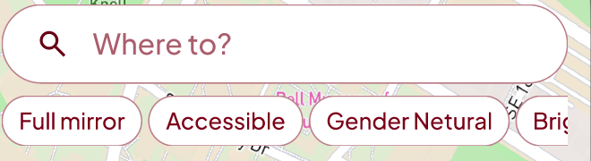
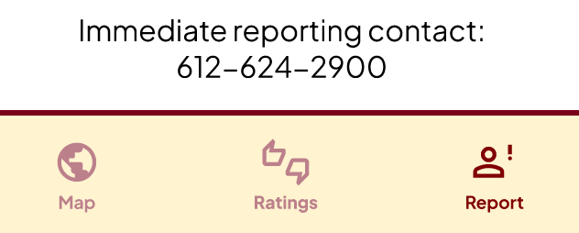
IDEATION
Potential Solutions
Filter features to search for bathroom based on user’s need → quick and convenient search
FAQ screen
Streamlined report system
Help user report problems faster (immediate number displayed)
Have a rating feature to allow the community to share feedback to one another
→ make the bathrooms experience better on campus overall

Slide 5
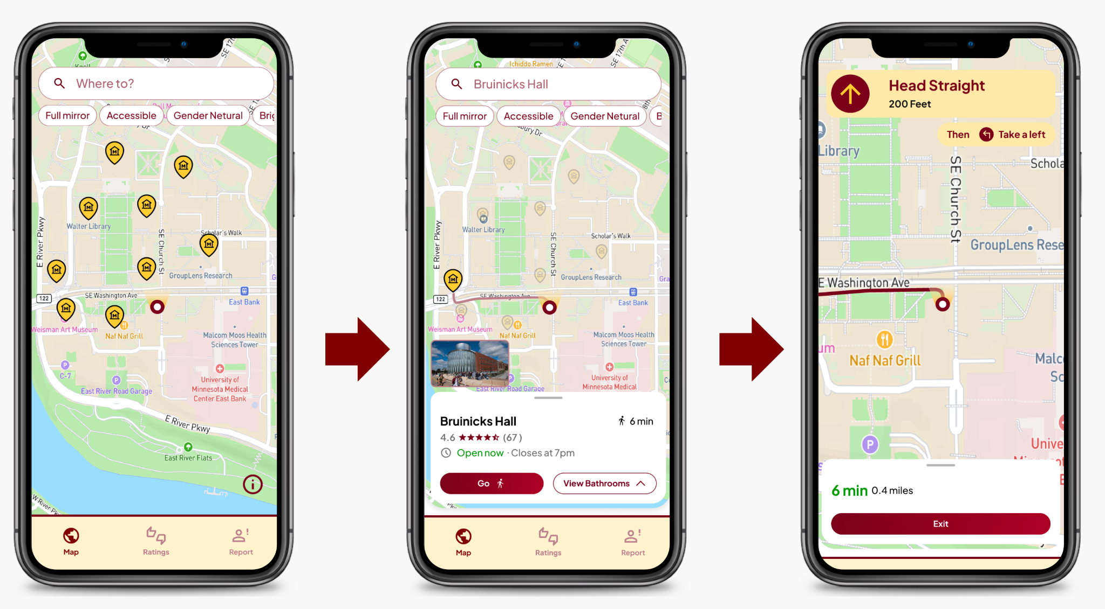
FINAL DESIGN: NAVIGATIONS

Slide 6
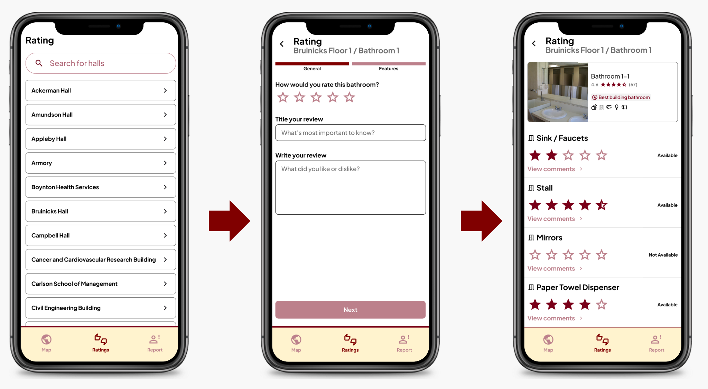
FINAL DESIGN: RATING/REVIEWS

Slide 7
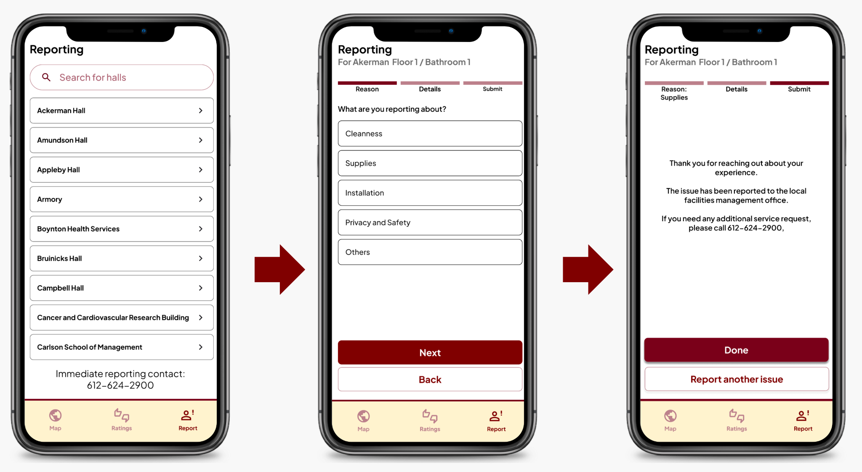
FINAL DESIGN: REPORTS

Slide 8
USER TESTING DATA
Methodology
Findings
Name the tasks that users need to complete
“Think aloud” while completing the tasks
Most of the tasks can be accomplished easily
User don’t have great difficulty in any of the tasks
Users encounter some difficulties along the way. Some reasons are:
Unclear feedback
Missing links between some features transition
→ Overall, users like the aesthetic design of the app, and agree that the app will be practically useful and fun to use

Slide 9
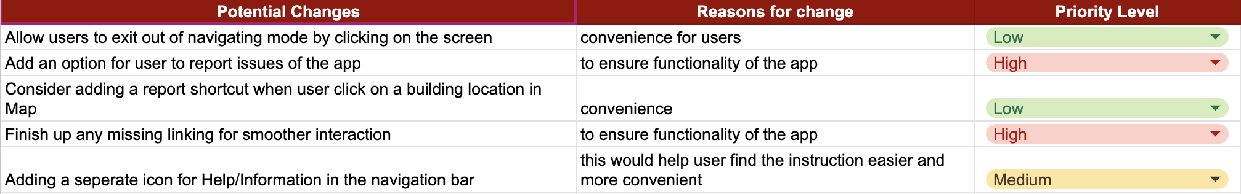
FUTURE IMPROVEMENTS
Address bugs and refine transitions
Add shortcuts, icons, and features (filtration system) to improve use experience

Slide 10
THANK YOU!
Q/A
Figma Link
Figma Files and Figma Flow

